Slide 1
SHAMIR’S SECRET SHARING SCHEME
CS51 – Final Project
Jared Faucher
Jonathan Penney
April 29, 2015

Slide 2
What is SSSS?
Shamir’s Secret Sharing Scheme (SSSS) is an Encryption/Decryption algorithm
Requirements:
Secret
Number of participants
Threshold

Slide 3
Encryption
To generate keys, a polynomial of (t-1) order must first be created!
Example: Secret = 1234
Threshold = 3
Number of participants = 6
Random polynomial: f(x) = 1234 + 166x + 94x²

Slide 4
Encryption
Integer Version BigNum Version
Secret: Integer String converted to BigNum
Polynomial: int list Bignum list
Number of
participants: int int
Threshold: int int

Slide 5
Encryption
Now to generate the keys, we simply evaluate the polynomial for however many number of participants!
f(x) = 1234 + 166x + 94x²
f(1) = 1234 + 166(1) + 94(1)² = 1494
f(2) = 1234 + 166(2) + 94(2)² = 1942
f(3) = 1234 + 166(3) + 94(3)² = 2578
….and so on for the rest

Slide 6
Keys
Keys are represented as (int*int) for the Int version of SSSS
And as (int*BigNum) for the BigNum version
Our keys:
(1, 1494), (4, 3402)
(2, 1942), (5, 4414)
(3, 2578), (6, 5614)

Slide 7
Decryption
Reconstructing the secret relies heavily on Joseph-Louis Lagrange’s Polynomial Interpolation Method
Requirements:
Threshold number of keys required
Threshold is 3 in our example so we need any combination of 3 keys!

Slide 8
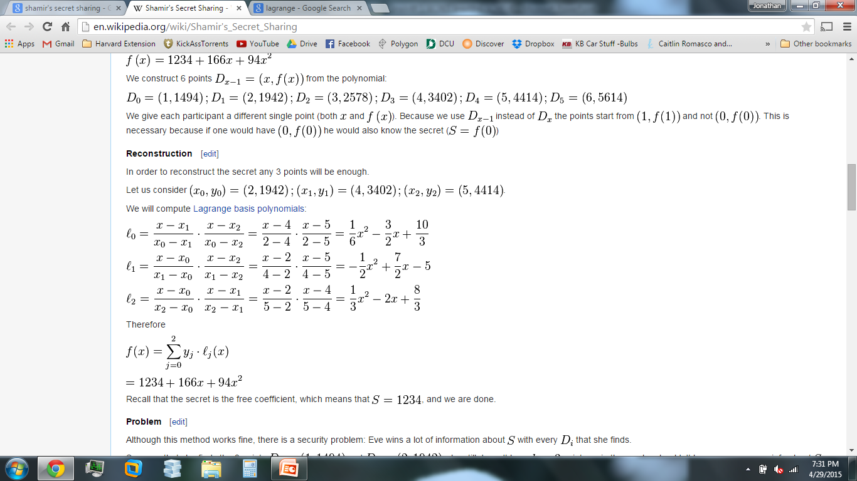
Decryption
For each given key, we generate a corresponding basis polynomial by applying the key’s x value in Lagrange’s formula.

Slide 9
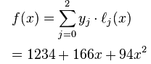
Decryption
Combine each basis polynomial using linear combination, where each Key’s corresponding y-value is multiplied by the basis polynomial, then summed to be…..
…the original polynomial!

Slide 10
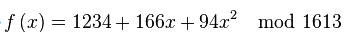
Secure/Insecure Version
The secure version uses finite field arithmetic to ensure that no additional information is gained from obtaining additional keys.
Slight change to the polynomial:
A random prime number is used

Slide 11
The Secret! What is it good for?
Suppose the President of the United States wants to launch a nuclear missile somewhere.
Let’s suppose that only 5 keys have been generated, one for the president, and one for each military General, but only 3 keys are required to launch.
SSSS would be a possible algorithm to safeguard the nuclear missile from accidental launch.

